Slide 1
Building Second Language Oral Proficiency Using Communicative Cohorts
Sarah Hord
Iris Myers
Christine Stanley

Slide 2
Objectives:
Increase
Increase oral and written production for beginning and intermediate language learners at Roanoke College
Improve
Improve communicative confidence for our language learners
Develop
Develop comprehensive language input for all the language modalities
Provide
Provide opportunities for connection of student’s personal cultural and cognitive space within a larger social context

Slide 3
Methodology
Communication: Communicate effectively in more than one language in order to function in a variety of situations for multiple purposes
Cultures: Interact with cultural competence and understanding
Connections: Connect with other disciplines and acquire information and diverse perspectives in order to use the language to function in academic and career-related situations
Comparisons: Develop insight into the nature of language and culture in order to interact with cultural competence
Communities: Communicate and interact with cultural competence in order to participate in multilingual communities at home and around the world

Slide 4
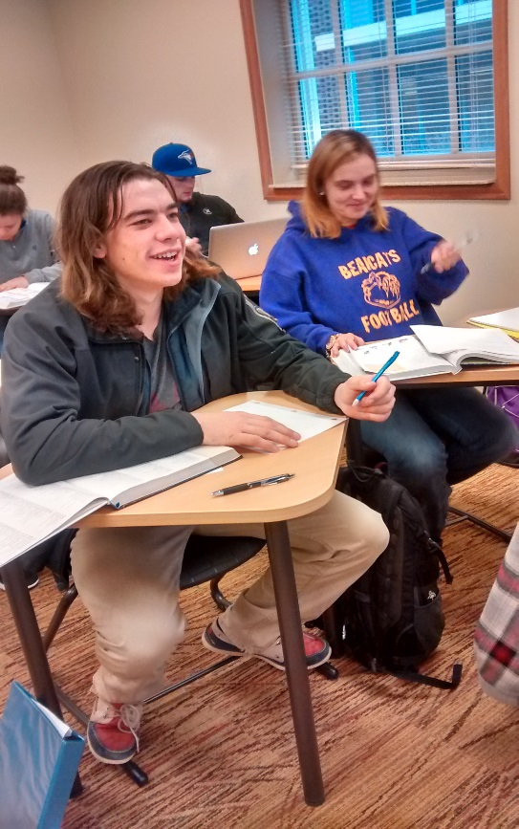
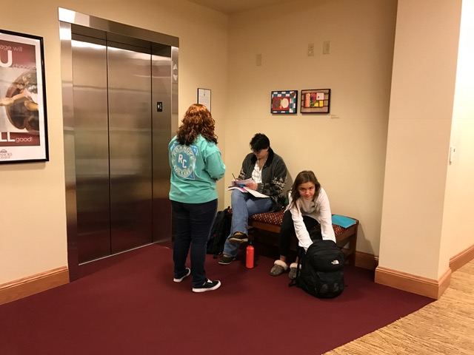
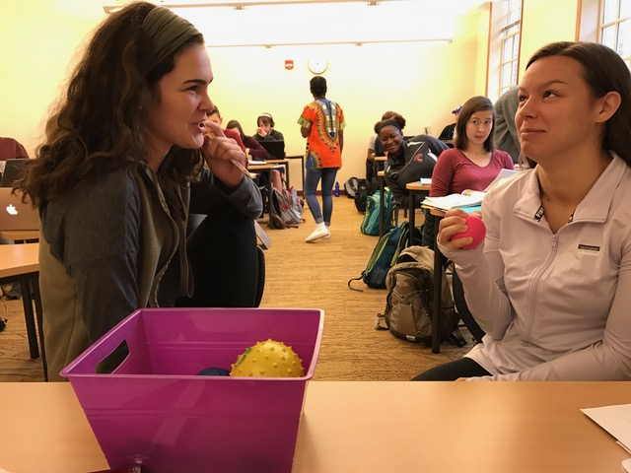
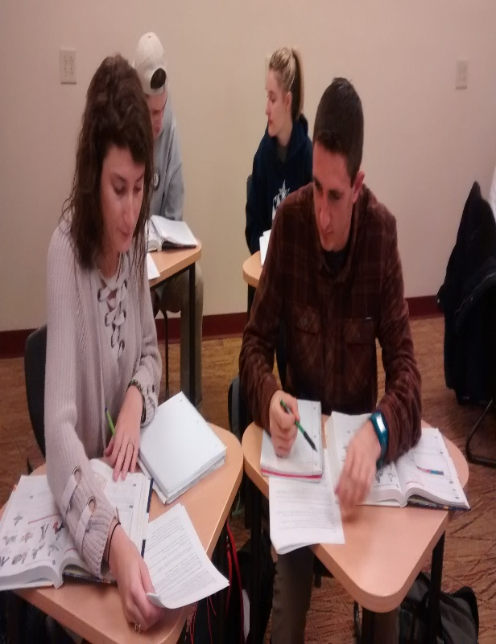
Student Engagement

Slide 5
Cohort Layout
Parte I: (Writing)
You are given 3 prompts to choose from.
There are some prompts that have guiding questions that will be there to help you.
All of the prompts will list exactly what needs to be written. (Follow the directions!)
Parte II (Speaking)
This will be done in partners.
You have 3 prompts to choose from.
You are allowed to practice before you speak in front of the professor.
All prompts will list exactly what needs to be said.
Must do this from memory.
Some of the prompts have pictures to go along with them.
Parte III: (Online)
Usually two activities that need to be completed online.
After doing these activities a professor or assistant need to initial that they saw your score.

Slide 6
Examples of cohorts activities:
-Must do Parte I, Parte II, and Parte III
-Differs every time

Slide 7
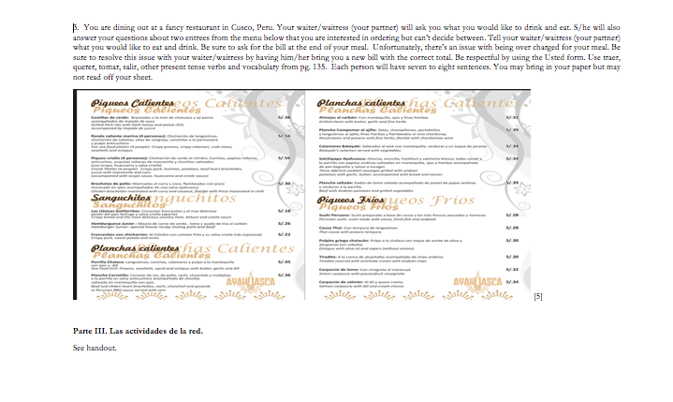

Slide 8
Survey Results
Questions | 2010-2011 (279) | 2011-2012 (286) | 2012-2013 (259) | 2013-2014 (242) | 2014-2015 (279) | 2015-2016 (184*) | 2016-2017 (221)
#2 I can communicate info about my daily routine. | 78.6% | 80.1% | 78.2% | 83.5% | 85.0% | 83.6% | 84.6%
#6 I can talk about activities that I will do in the future. | 58.3% | 55.0% | 44.7% | 53.1% | 53.8% | 62.0% | 74.6%
#7 If I were in a country where ______ is spoken, I would be able to order food at a restaurant. | 74.0% | 79.2% | 79.0% | 79.7% | 81.0% | 81.5% | 86.9%
#9 If I were in a country where ______ is spoken, I would be able to formulate questions related to situations such as asking directions or requesting basic info. | 63.0% | 68.4% | 58.7% | 64.2% | 68.4% | 69.0% | 61.1%
#11 If I were in a country where ____ is spoken, I could arrange for lodging with the desk clerk and check in. | 47.6% | 48.2% | 46.3% | 53.7% | 56.0% | 59.2% | 62.3%

Slide 9
Grade Data Analysis

Slide 10
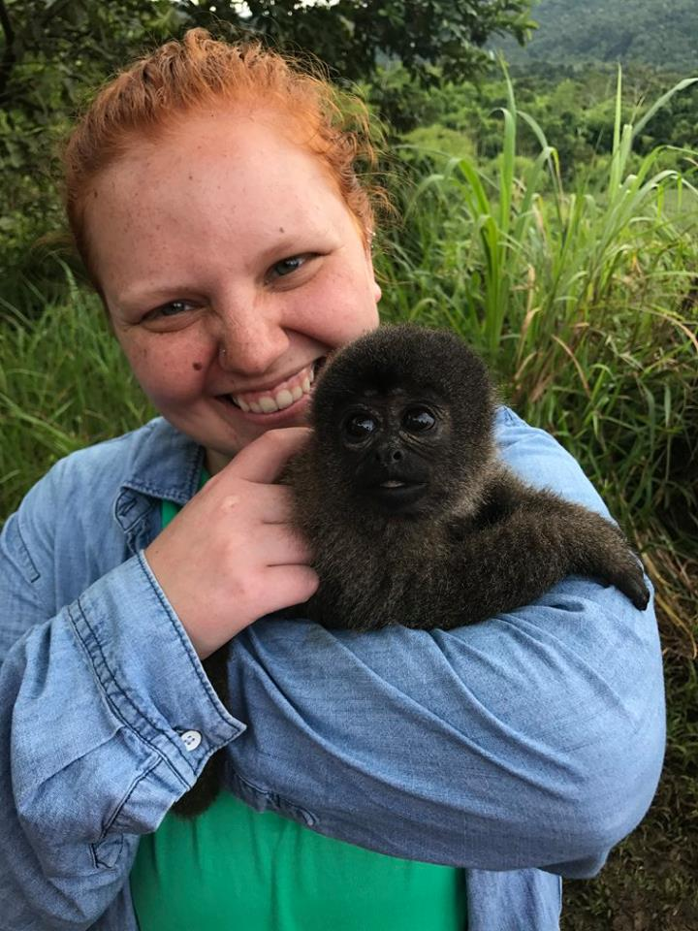
Allie Woomer Reflection-Cohort Leader
I have really enjoyed having the opportunity to be a cohort leader. It allows me to interact with the students more, so I can build a relationship with them. A lot of the students that come to the tutor center are students that I have met through doing cohorts. I have also improved in my Spanish a lot from helping the other students as well.

Slide 11
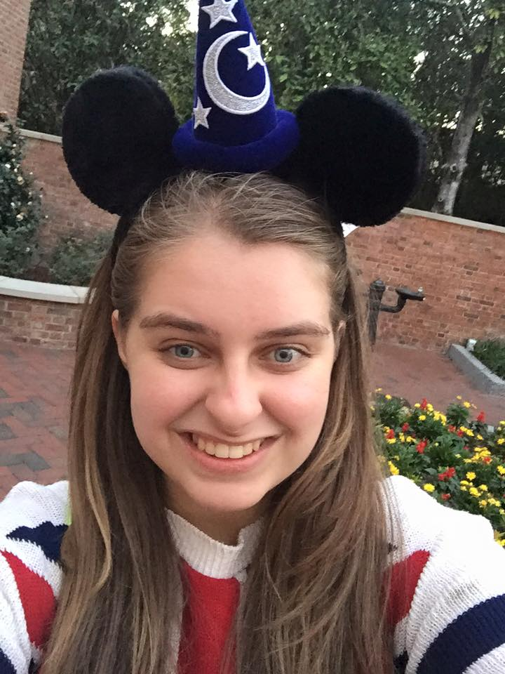
Olivia Lee- Student
Entering into Spanish 101 with little success in studying a language, I was hesitant as a language learner. Without study techniques, I was sure that Spanish would be a difficult class and a struggle academically. However with activities, such as Cohorts, I was able to gain skills and confidence in a modern language. By the time I was in my third semester of Spanish, Cohorts continued to improve my language skills. Now, two years after taking Spanish, I still use the skills I acquired during Cohorts. As a future elementary teacher in the United States, I am able to communicate with English Language Learners and write lesson plans that will be engaging and constructive.

Slide 12
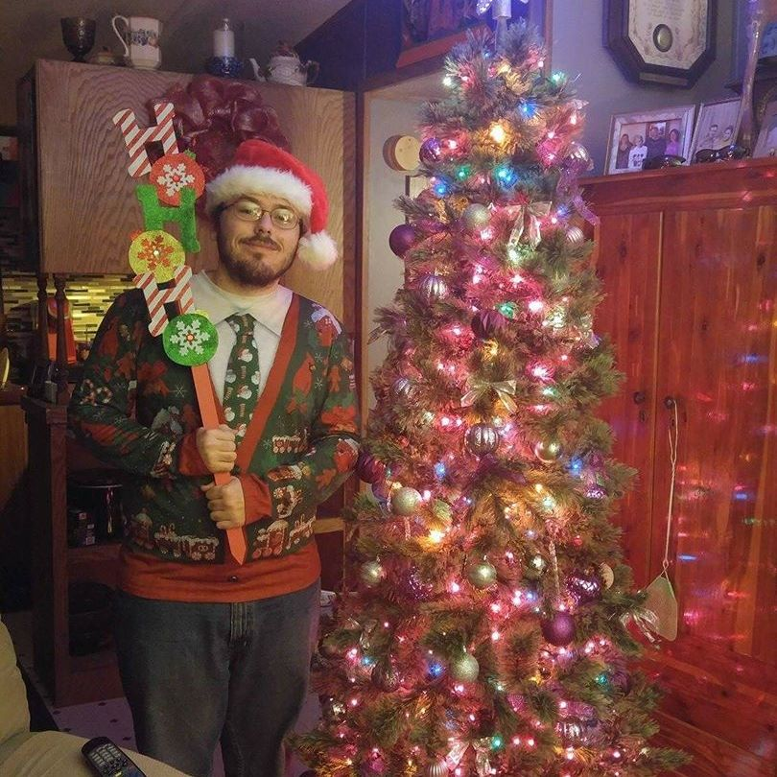
Ryan Cash- Student
I have very much enjoyed the cohort activities in my three semesters taking Spanish at Roanoke College. On a personal note, when I was in high school, I took Spanish for two semesters worth, and performed well-below average in each of those semesters, barely achieving a C-grade. I did not take a modern language course in college until my junior year, when I began taking Spanish with Professor Myers. I quickly learned Spanish at a much faster rate by participating in the cohort activities, as it gave me an opportunity to practice my Spanish speaking and writing, without the looming pressure of an exam grade hanging over my head. The cohorts also gave me the opportunity to interact with other members of my classes, as we were split into pairs for the activities. This interaction led to me meeting some pretty good people that I still say hello to whenever I see them around campus. All-in-all, the cohort activities were an extremely positive influence for me in my three semesters taking Spanish here, as I learned much more at a faster pace than I had in my previous experiences with the language.

Slide 13
Conclusions
Students have increased, low-stakes opportunities to produce communicative output in the target language
Improvement of proficiency
Students are engaged in dynamic and meaningful exchanges while utilizing target grammar and vocabulary within these communicative tasks
Cohort activities are well-received by students and by the faculty of Roanoke College
Student cohort leaders derive great benefits from working with students in the classroom
Funding and pacing still present issues each academic year
Modifications are made each semester to accommodate the needs of the students and/or faculty

Slide 14
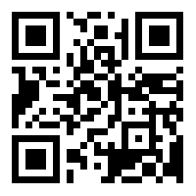
Contact Us for More Information: http://bit.ly/2zknvy2
Sarah Hord- hord@roanoke.edu
Iris Myers-imyers@roanoke.edu
Christine Stanley- cstanley@roanoke.edu

Slide 15
References:
NCAT Homepage, Accessed 19 September 2017. Retrieved from http://www.thencat.org/
World-readiness standards for learning languages, Alexandria/VA: National Standards in Foreign Language Education Project, 2015.
Choice Boards, Accessed 19 September 2017. Retrieved from https://daretodifferentiate.wikispaces.com/Choice Boards change
M.O. de Castells, E. Guzmán, P. Lapuerta, and J.E. Liskin-Gasparro, Mosaicos. Upper Saddle River/NJ: Pearson Custom Publishing, 2015.
Ayahuascarestobar Restobar Lounge, Accessed 4 August 2017. Retrieved from http://ayahuascarestobar.com/
K.S. Bradley and J.A. Bradley, Scaffolding Academic Learning for Second Language Learners, The Internet TESL Journal. Accessed 23 September 2017. Retrieved from http://iteslj.org/Articles/Bradley- Scaffolding/
K.S. Agee and R. Hodges, Handbook for training peer tutors and mentors. Mason/OH: Cengage Learning, 2012.
White D. Home, CRLA, Accessed 19 September 2017. Retrieved from https://www.crla.net/index.php/certifications/ittpc-international-tutor-training-program
ACTFL. Accessed 23 September 2017. Retrieved from https://www.actfl.org/sites/default/files/pdfs/public/ACTFLProficiencyGuidelines2012_FINAL.pdf
ACTFL, NCSSFL-ACTFL Can-Do Statements, Accessed 19 September 2017. Retrieved from https://www.actfl.org/publications/guidelines-and-manuals/ncssfl-actfl-can-do-statements

