Slide 1
Commercial Card
Expense Reporting (CCER)
The Trustees of Roanoke College
An internet solution
Accessed via Wells Fargo’s secure Commercial Electronic Office® (CEO) portal

Slide 2
Commercial Card Expense Reporting (CCER)
What is it?
CCER is an internet reporting solution that allows on-line access to your card transactions at any time, from any location. It is accessed via Wells Fargo’s secure Commercial Electronic Office® (CEO®) portal.
Cardholders can:
Review/reclassify transactions
Input a business description for all transactions
Split transactions
Approvers can:
Review/approve cardholder statements
View statement summary reports

Slide 3
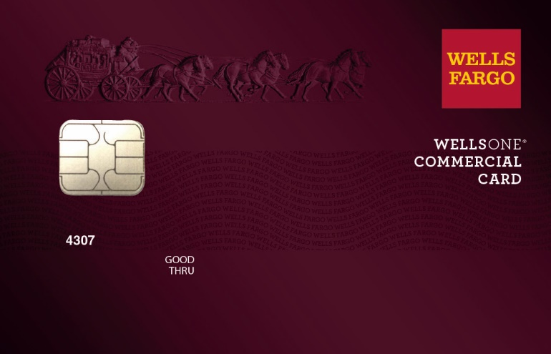
To get started
After receiving your card…
Activate your card by calling the toll free number located on the activation sticker
During activation you will need your Unique Identification Number (ID) - if you do not know your Unique ID, please contact your internal Program Administrator to obtain
During activation you will be asked to create a customized Personal Identification Number (PIN)
Sign the back of your card
Record the Wells Fargo Customer Service number (1-800-932-0036) located on the back of your card in your mobile device, or address book
Sign on to the CEO and initialize your CEO User ID

Slide 4
Chip and PIN Card Information
To enhance the security of your credit card purchases, your new commercial card features chip and personal identification number (PIN) technology, in addition to a magnetic stripe. With this card, you will have added identity verification and more flexibility at chip-enabled and traditional magnetic stripe terminals. Please review the important information below to help you get started with your new card.
About chip-enabled cards
  Over the next year, U.S. merchants will begin using terminals that accept chip-enabled credit cards. Until then, you may use your card by swiping at the point of sale, just as you do today.
  As chip-enabled terminals are already being used internationally, you may use your card to complete chip-enabled transactions in Europe, Asia, South America, and Canada.
Getting started with your new card
To activate your card, you will need your unique identification (ID) number. If you do not know your unique ID, please contact your program administrator.
Activate your new card immediately by calling 1-800-932-0036, 24 hours a day, 7 days a week.
  When dialing from outside the U.S. or Canada, dial 001-800-932-0036. This is not a toll-free number when calling internationally.
  If you need help internationally, please call customer service collect at 1-612-332-2224.
When you activate your card, you will select a personal identification number (PIN). Use this PIN for chip-enabled transactions when prompted by the terminal. This same PIN will be used for cash advances, if you are authorized to make them. Depending on the terminal set-up, you may be prompted to provide your signature instead of your PIN. Once activated, the card is ready for use at either mag stripe terminals or chip enabled terminals.
If you forget or need to change your PIN, call the WellsOne Service Center at 1-800-932-0036, option 2, option 1.2.

Slide 5
New User Sign On
Sequence of steps
Sign on to the Commercial Electronic Office® (CEO®) using your temporary password
Change your password
Set up your secret questions
Read and accept the CEO Terms of Use
Confirm your profile information
Notes:
If you will be using an RSA SecurID® token device, we'll cover that topic after the first-time sign-on steps.
We'll begin with how to access the CEO portal itself…

Slide 6
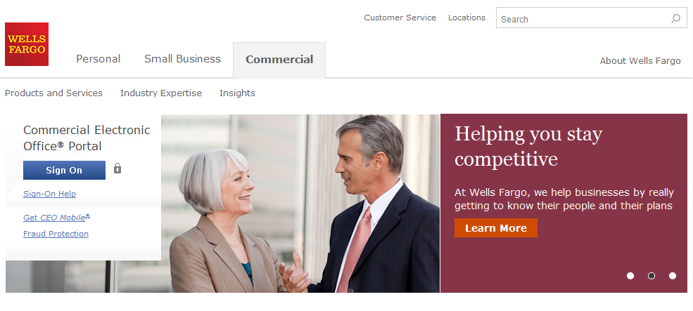
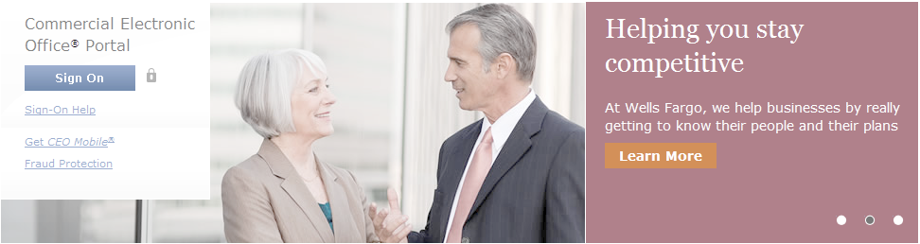
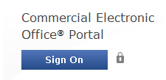
Wells Fargo home page wellsfargo.com

Slide 7
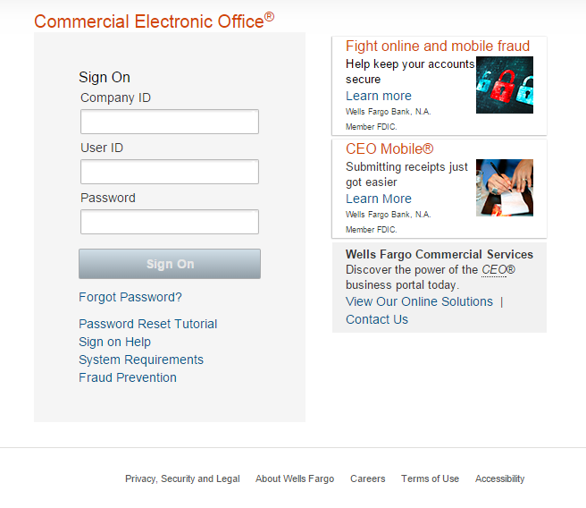
CEO portal sign-on website https://wellsoffice.wellsfargo.com
Enter your:
Company ID
  TRUST898
User ID
  Unique to user
Password
  Unique to User
Company ID, User ID and Password
are not case sensitive
To change or reset your password, click the Forgot Password? link.
If you incorrectly enter your password twice in the same session, you will automatically be taken to the Change Your Password page.

Slide 8
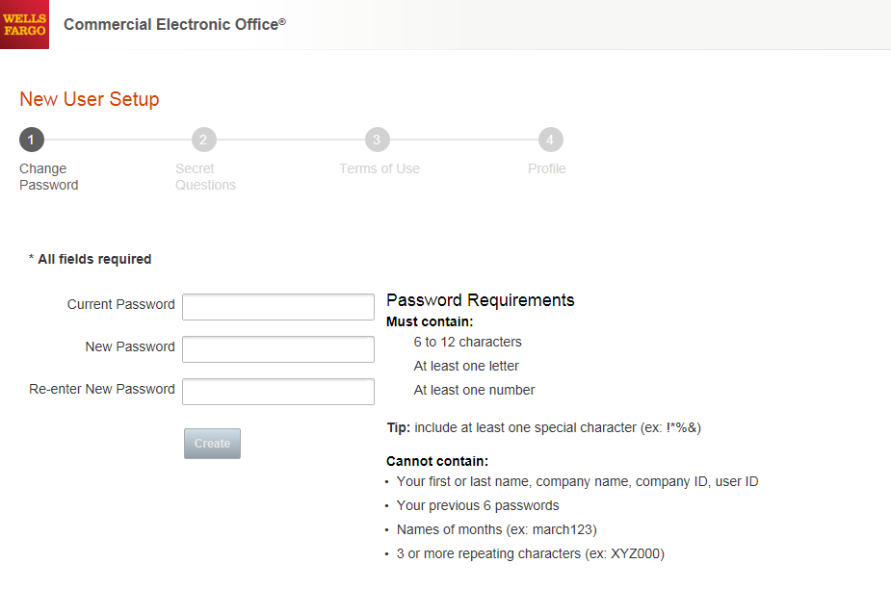
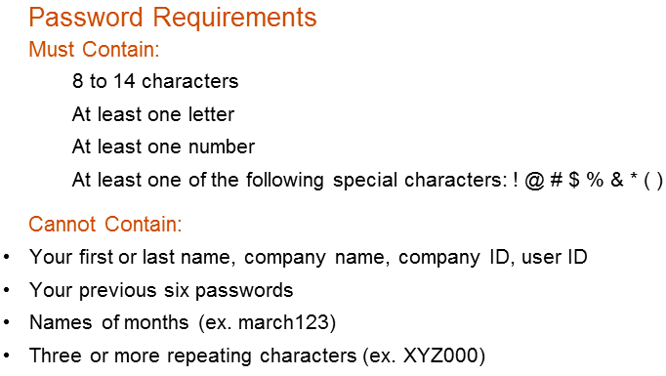

Change your password
●●●●●●●●●
●●●●●●●●
●●●●●●●●

Slide 9
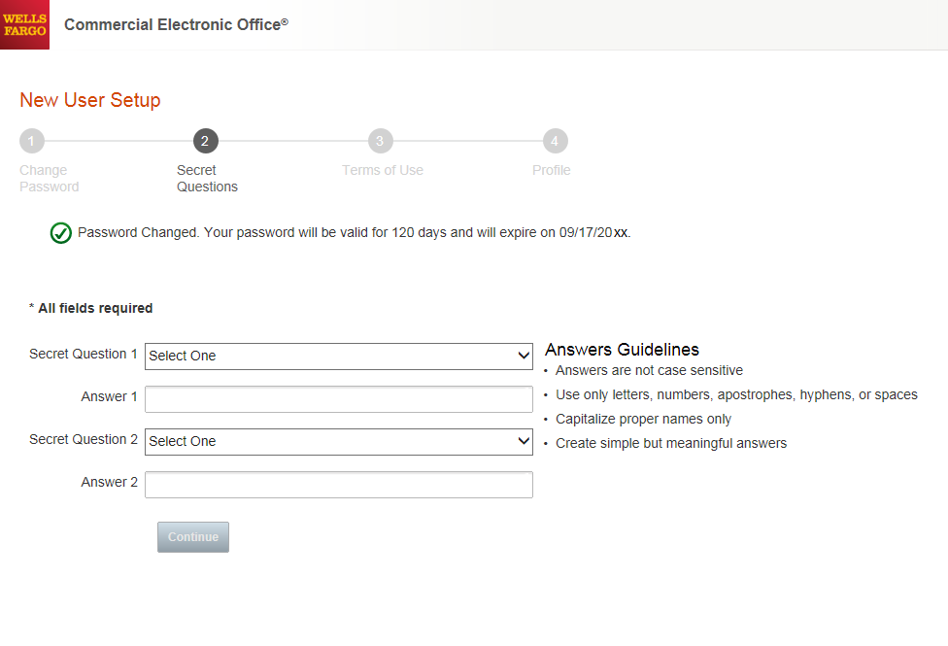
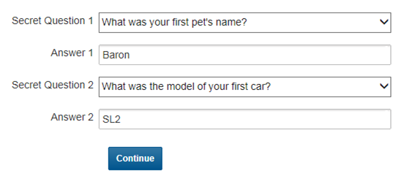
Set up your secret questions

Slide 10
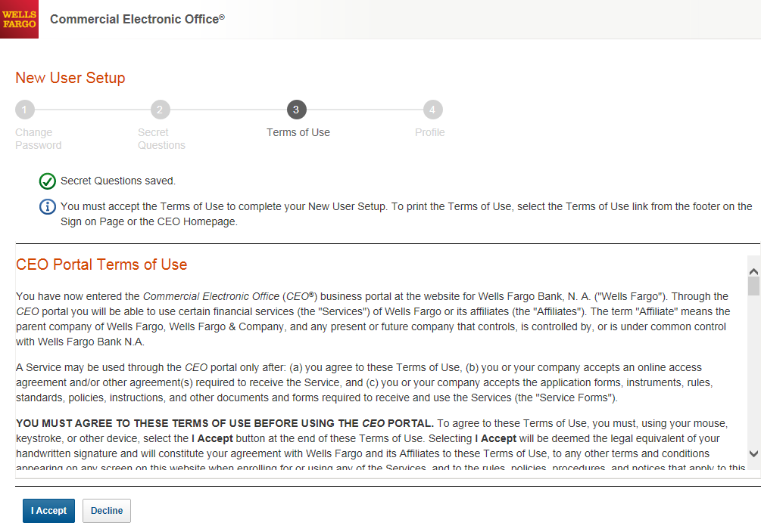
Read and accept the CEO Terms of Use

Slide 11
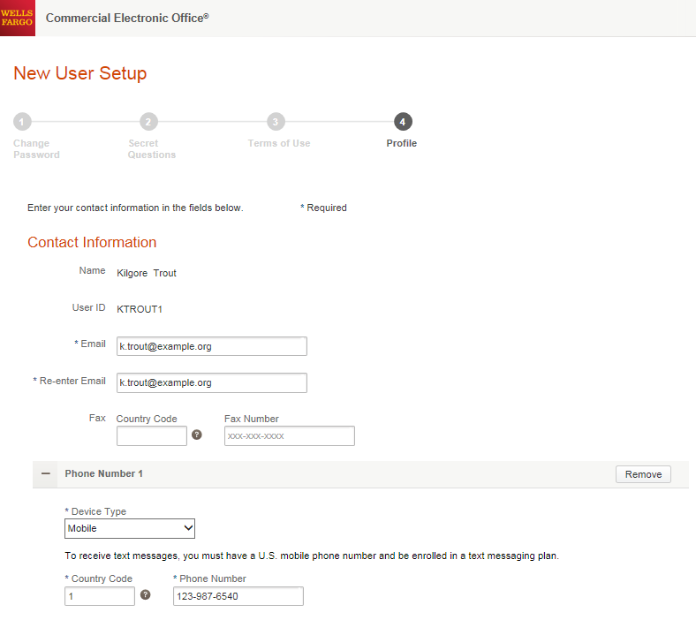
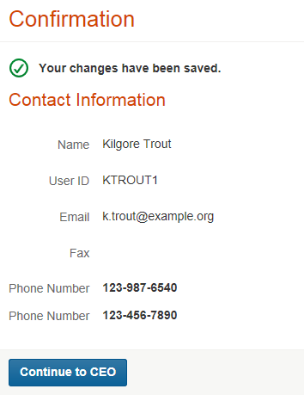

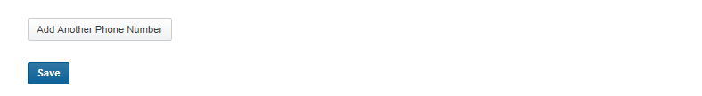
Confirm your profile Contact Information
Enter your email and phone information; Save, then Continue…

Slide 12
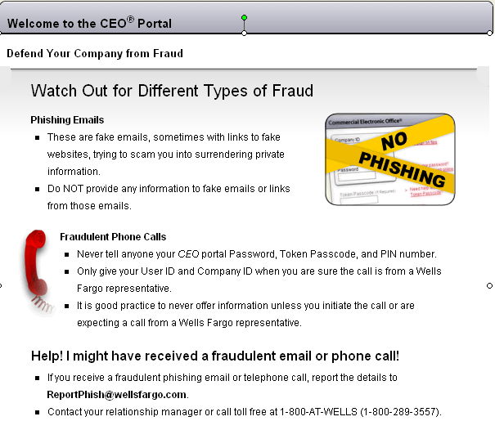

Slide 13
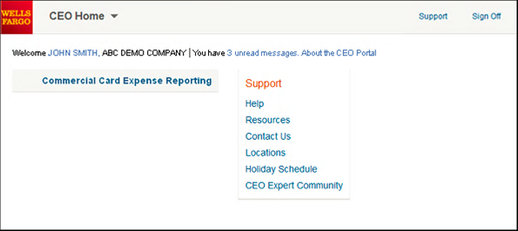
CEO home page
Click the link for Commercial Card Expense Reporting. A separate browser window opens and displays the CCER service
Click on Support to register for free online CEO product training
Click on Help for assistance and training
To automatically display CCER when you sign on to the CEO portal, click the link for your user name to set up Automatic Access
On the profile page, click the Edit link under Preferences
Set Automatic Access to the desired setting and click Save

Slide 14
Contact information
WellsOne Service Center - 1-800-932-0036
  From outside of the United States call 1-612-332-2224
  Call immediately if your card is lost, stolen or suspected missing
  For immediate decline information
  To access the automated voice response system for the following information:
    Current balance
    Available credit
    Reset PIN
Contact a program administrator if:
  You have questions about your card
  Need to increase your credit limit
  Change jobs
  Need to order cards for other employees
Program Administrators:
Kristen Douglas
Rachael Freeman
Rhonda Hibbitts
Adam Neal
Kathryn Vanness

Slide 15
Approver experience

Slide 16
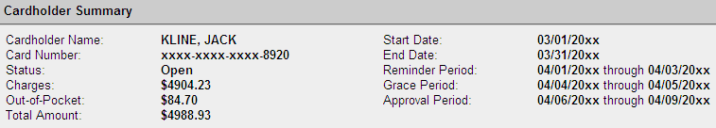
Approver review period
Review your company’s unique CCER statement cycle, and Approval Period within the Cardholder Summary located at the top of the Review Open Statements and View Cycle-to-Date screens
An email will be sent to the Approver once Cardholders have submitted their statements for approval (Statement Reviewed). An additional email will also be sent listing any Cardholders that failed to submit their statements by the grace period end date.
Approvers must approve all statements by 4 calendar days after the end of the Cardholder period.
If you are on vacation, or do not have online access, contact your Program Administrator so a secondary Approver can be assigned to your Cardholders.

Slide 17
E-Mail notification
Cardholder review of statement is complete
Cardholder statement review complete
Dear Approver:
The most recent statement has been reviewed for the following cardholder:
Lastname, Firstname
xxxx-xxxx-xxxx-1234
xxxx-xxxx-xxxx-5678
The statement(s) are ready for your review by accessing the
Wells Fargo Commercial Card Expense Reporting system
Please complete your review in a timely manner.
This is an automated email. Please do not reply to this message.

Slide 18
E-Mail notification
Approver mail (after grace period end date)
Cardholder statement review overdue for 05/31/20XX
Dear Approver:
The following cardholder(s) have not reviewed their most recent statement:
Lastname, Firstname xxxx-xxxx-xxxx-1234
Lastname, Firstname xxxx-xxxx-xxxx-5678
Notifications have been sent to each cardholder but they have still failed to review their statement. If you choose, you may review the statement on the cardholder’s behalf by accessing the Wells Fargo Commercial Card Expense Reporting system.
This is an automated email. Please do not reply to this message.

Slide 19
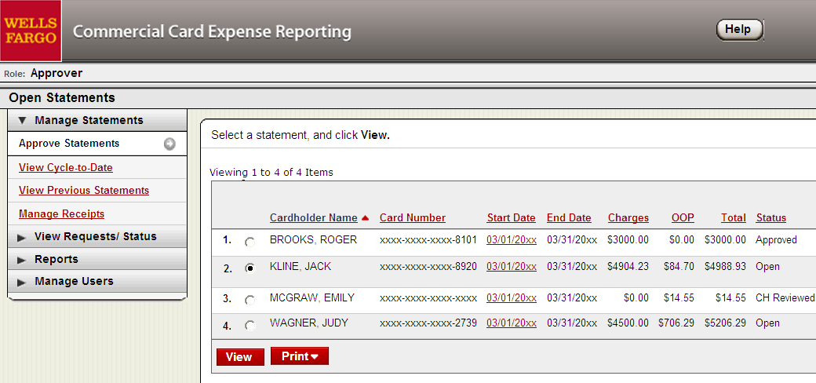
Approver home page
Manage Statements – Approve Statements
Statement approval queue (if the cycle is ready for review)
Notify program administrator if a secondary approver is needed

Slide 20
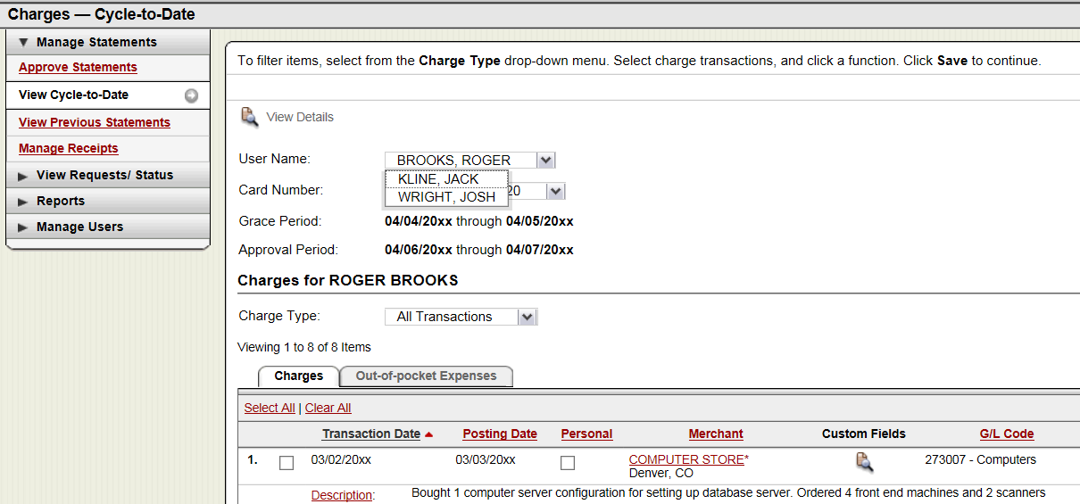
Manage Statements
View Cycle-to-Date Transactions
Approvers can view activity for any cardholder that rolls up to them for approval

Slide 21
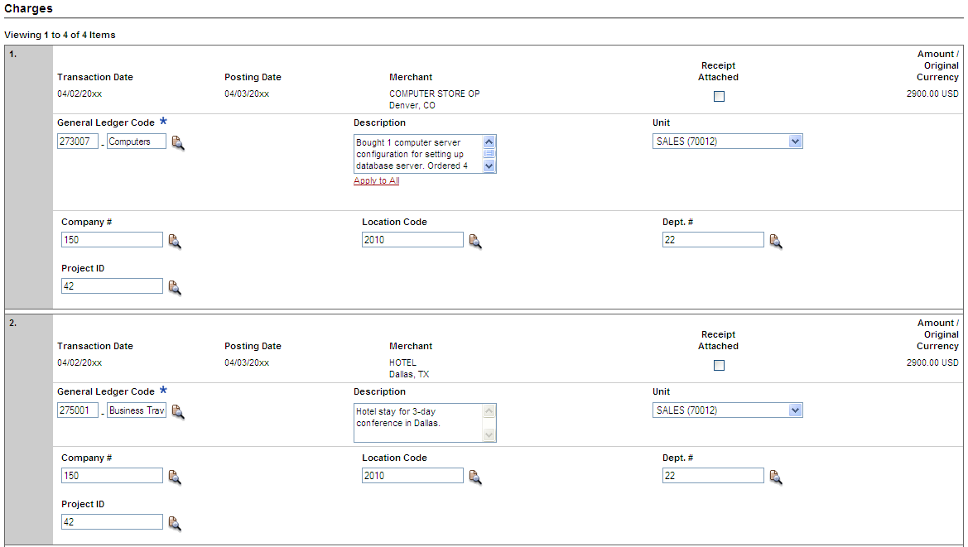

View reclassifications
View transaction details
Make changes if necessary

Slide 22
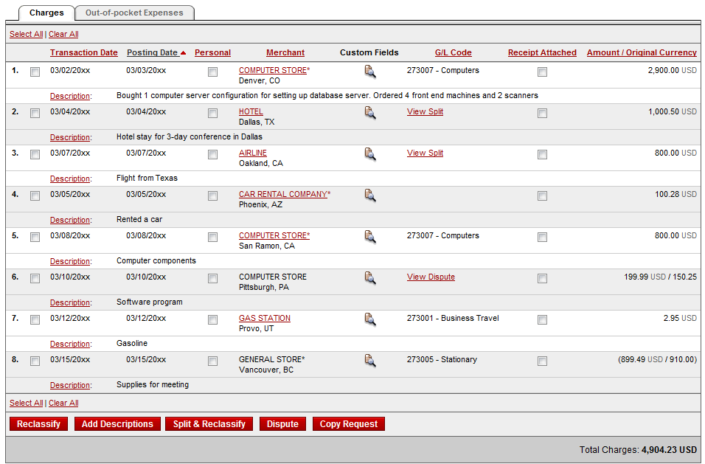

Statement approval
Review transaction detail, descriptions, receipts, and make sure all are in compliance with company policy for charges
Approve the card expenses by clicking “approve statement”

Slide 23
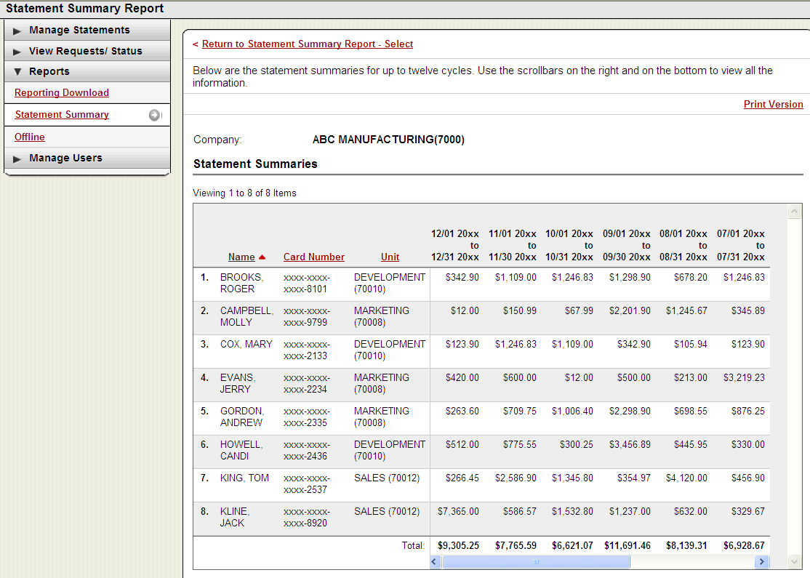
Reports – statement summary
Approver option – review up to 12 statement cycles
Statement summary report showing cardholder statements over period of time

Slide 24
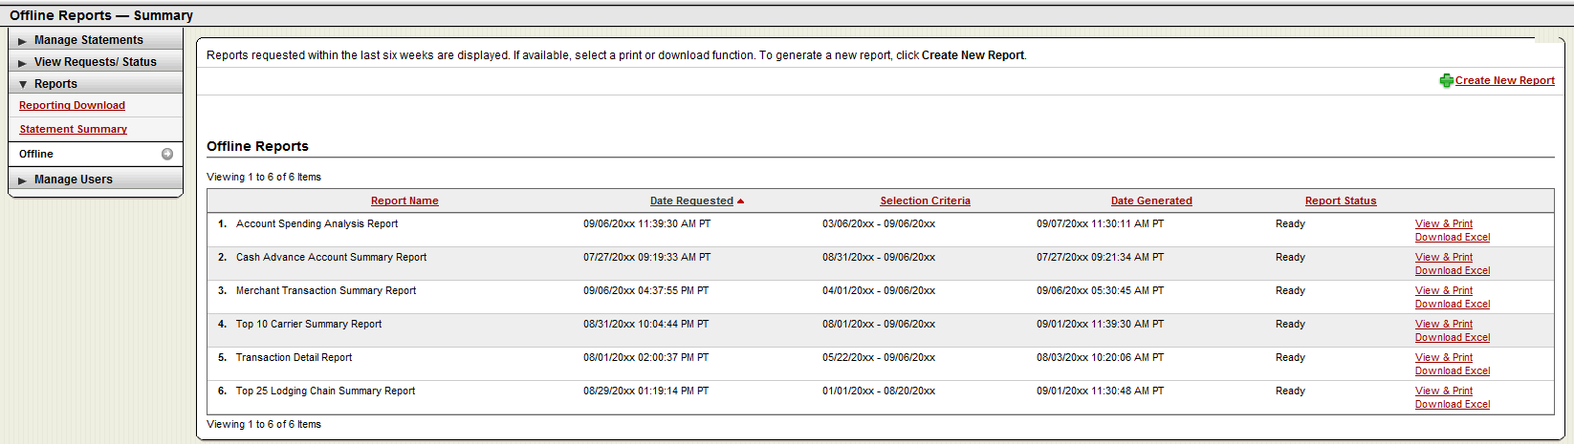
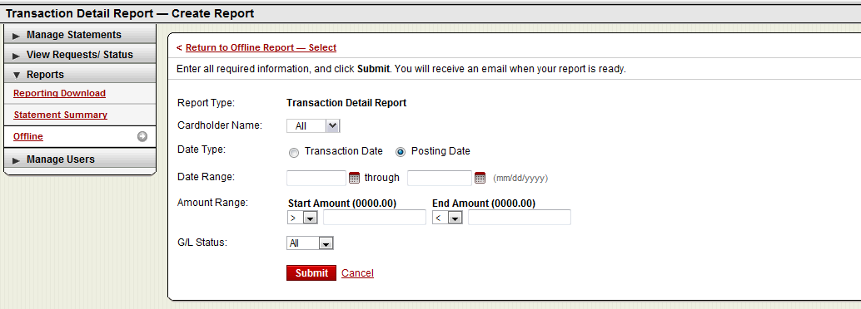
Reports – offline
Approver option – Create New Report
View & Print (PDF) or Download report data to Excel
Approver will receive an email when the report is ready to view

Slide 25
Thank you!
© 2016 Wells Fargo Bank, N.A. All rights reserved. Confidential.

